Slide 1


Slide 2
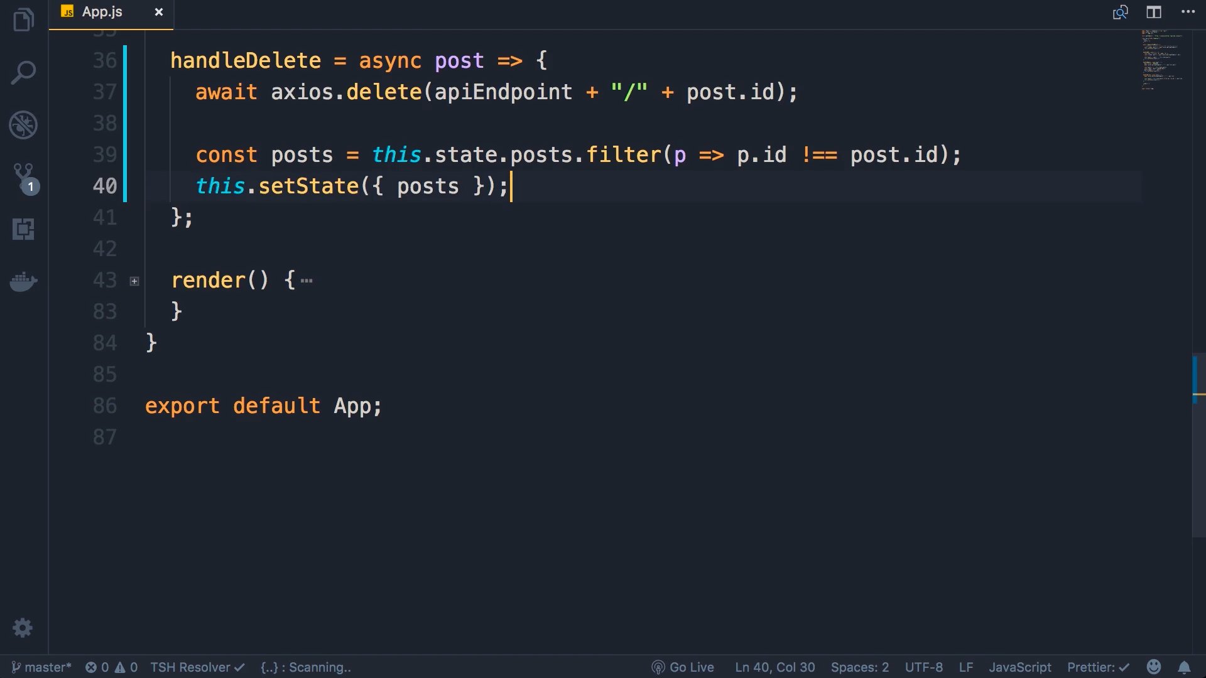
For delete we need to end point followed by the id of the post which we intended to delete

Slide 3
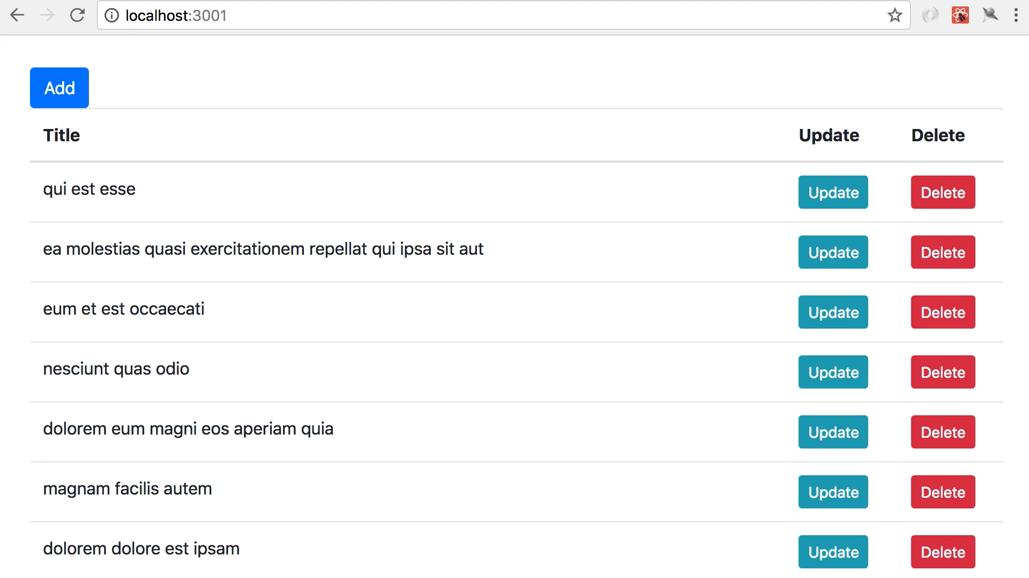
Click on delete and you see that the post is deleted

